Slide 1


MSIL – Smart Spares Digital Twin Platform
17th February 2023
July 2020

Slide 2


Project Understanding
System architecture
Execution Approach
Our Experience
Why Happiest minds? (Slide to be shared)
AGENDA

Slide 3


Project Understanding

Slide 4
Our Understanding of the Requirement
A system which can display warehouse data points encompassing Receipt, Binning, Picking, Inventory and Dispatch operations
Receipt : receipt of material from different vendors with various datapoints captured involve the journey of a
vehicle carrying the incoming material from MSIL In gate to MSIL Out gate via Dock In and Dock Out with varies filters
Statistics showing critical data points for dock management, part order status, rejection status, TAT monitoring, truck monitoring
Binning involves keeping the inwarded stock at respective locations, hence we need to track part order status,
oldest pending date status and binned carton status
Picking involves picking the required material from respective locations based on the pick list generated where it also becomes
important to track VOR (vehicle off road) orders
System based Storage Capacity Dashboard to be made using SKU_Master, CMT and Inventory by Location reports
Inventory management is important to ensure live visibility of the stock in order to efficiently serve the orders.
Post picking and consolidation, the material must be loaded and dispatched to respective consignees
The important data parameters to be tracked are vehicle gate in and gate out time, dock in and dock
out timings, sequence number, TAT, order picking status
The user will be enabled to use various filters like consignee, warehouse, transporter, location of
vehicle and TAT
From CL03 / WMS / SMART / SPACE data sources respective data sets are retrieved on regular interval for live tracking
Slide 4

Slide 5
Scope of the Project
In Scope
Out of Scope
Design & Development of Smart Spars Digital Twin
Consumer web application
Infrastructure on AWS cloud
Functional & Performance Testing
API Test Automation
Application Security
CL03 / WMS / SMART / SPACE Data push from stream
UI/UX Design
Testing Simulators
UI test Automation
User manual, SOP, Run book
PEN Testing
Building Data lake from Source data set
Build a Digital twin platform

Slide 6
Assumptions
MSIL will provide the CL03 / WMS / SMART / SPACE required data source and access details to fetch data on regular interval.
Live data refresh of Inventory, Binning, Receipt, Dispatch related data sets will be schedule intervals confirmation based on MSIL.

Slide 7
System Architecture

Slide 8






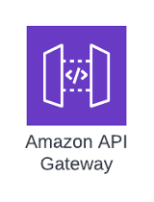









System Architecture
Admin User
Containers
Smart Spare Service
Smart Spare Analytics
Receipt service APIs
Digital Twin Web App
Receipt
Binning & Inventory
Dataset Integration ETL
Dispatch APIs
Binning/Inventory/Picking
SES
Notification Service
DB
Dispatch
RBAC Service
Dataset Service
Cloud watch
RBAC – Configuration UI
Report Service
Reports
AWS Glue
Lambda
Authorizer
Secret manager
Scheduled Jobs
MSIL ADFS
CLO3
SPACE
WMS
M-SMART
Data lake
Will be considered in future.
Alternate approach incase Data lake not ready

Slide 9
System Architecture – Design Considerations
Cloud First Design
Microservices / API First
Scalable
Modularity
Maintainability
Single Page Application for web app implementation
Securable
Performance
Use existing MSIL Authentication System
Platform Services
Application will have a set of well-defined microservices which will be deployed on Serverless Architecture
All the REST APIs will be exposed through API gateway.
All API responses will be in JSON format except report CSV download.
APIs will be secured through access token (JWT) which will be passed over the auth header on request. All communications are over HTTPS.
Microservice reference archetype standardizes the services.
A combination of both event-driven and REST approaches will be considered for interservice communication and third-party integration.
All frequently accessed data will be stored in cache for improving API latency.
All microservices logs will be pushed to centralized logging system.
Slide 9

Slide 10
System Architecture – High Level Approach
The following are the major services
Smart Spare Service: This service is responsible for communication between the Smart Spares web application and the Smart spares platform. This is system is responsible for providing API for below features list
Receipt
Binning
Picking
Inventory
Dispatch
Reports
Notification
RBAC
Data Set Integration API Service: This service will have well-defined REST APIs which will be invoked regular interval frequencies from schedular job and pull latest data set from CL03 / WMS / SMART / SPACE data sources for Part Order Status, TAT Monitoring, DI & Rejection Status, Oldest Binning date Status, Binned Carton Status, Binning Rewards, Picking Performance, VOR Status, Inventory level monitoring, Floor wise FMS analysis, Same part in Multiple location, MGP Report, Loading Plan, Gate In and Gate Out Report, WMS Sequence Data Tracking
Slide 10

Slide 11
System Architecture – High Level Approach
Authentication & Authorization
Authentication for MSIL users to access spare sparts platform will be done using MSIL Active Directory (AD).
Once the authentication is successful, a JWT token will be generated which will be used for all subsequent API calls.
RBAC service will be used for providing role-based access to the system based on permissions.
Data Set Integration Service: This service will be developer as microservice which interact with MSIL data lake platform which built up based the data sources such as CL03 / WMS / SMART / SPACE data sources for Part Order Status, TAT Monitoring, DI & Rejection Status, Oldest Binning date Status, Binned Carton Status, Binning Rewards, Picking Performance, VOR Status, Inventory level monitoring, Floor wise FMS analysis, Same part in Multiple location, MGP Report, Loading Plan, Gate In and Gate Out Report, WMS Sequence Data Tracking
Smart Spares Web Application: Smart Spares presentation layer will be deployed in AWS S3 bucket along with CloudFront. Web application and backend server will communicate over HTTPS using REST APIs for exchanging data. The proposed solution will have the following major components in the presentation layer.
User management & RBAC
Receipt
Binning
Inventory
Notification
Reports
Slide 11

Slide 12
System Architecture – High Level Approach
Presentation: This layer contains the components that implement and display the user interface and manage user interaction. This layer primarily prepares and displays the data in the mobile user interface.
Business: This layer concerns the logic and rules for data exchange, operations, and workflow regulation. The components in this layer work with the presentation layer and handle the App behavior within the scope of the use cases defined by communicating further down with the service layer. This layer encapsulates the entities and the business logic.
Service: This layer works with the business layer implementing a set of core services defined within the scope of the use cases.
Data: This layer stores the application data in the preferences, the connected device data in the database The business layer should rely on the Persistent Service if it has to fetch the required data to be presented to the user.
Third Party Libraries: This layer includes Google Map SDK, Chatbot SDK, Payment SDK, Community Forum SDK which will get integrated with service layer for consuming the respective APIs.
Web Application
Slide 12

Slide 13
Execution Approach

Slide 14
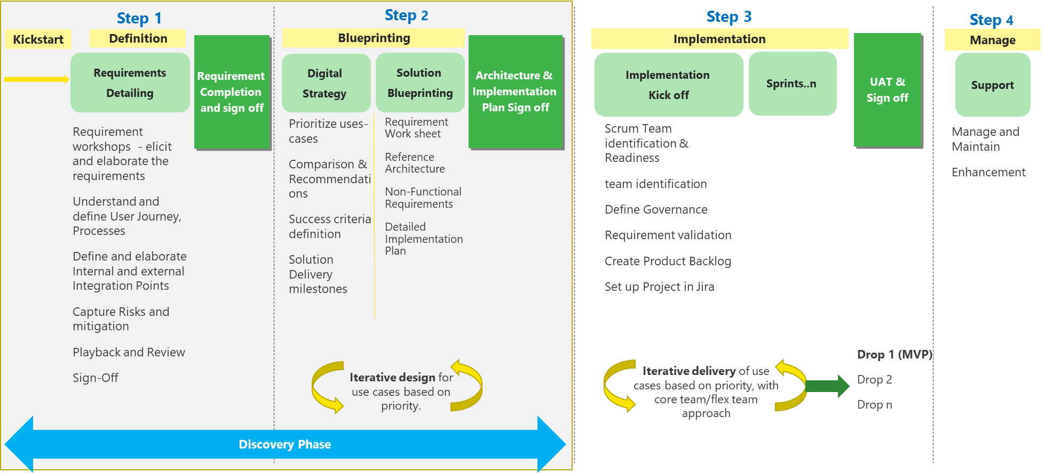
Overall Execution Approach

Slide 15
Discovery Phase (Step 1 & 2)

Slide 16
Proposed Team for Discovery Phase
Happiest Minds
MSIL
# | Project Role
1 | Program Manager
2 | Platform Architect
3 | FrontEnd Lead
4 | Backend Technical Lead
5 | FrontEnd Developer
6 | Backend Developer
# | Project Role
1 | Product Owner
Requirements/Functional specifications for Platform
Identify and detail out all the NFRs
Requirement Interface document
Identify any summarize Analytics Requirements
Create Data/Process workflows
Create Product Backlog for MVP1, 2 and 3
Feasibility POCs
High level Solution Blueprint
Implementation Roadmap and Plan

Slide 17
Tentative Schedule and Key Deliverables

Slide 18
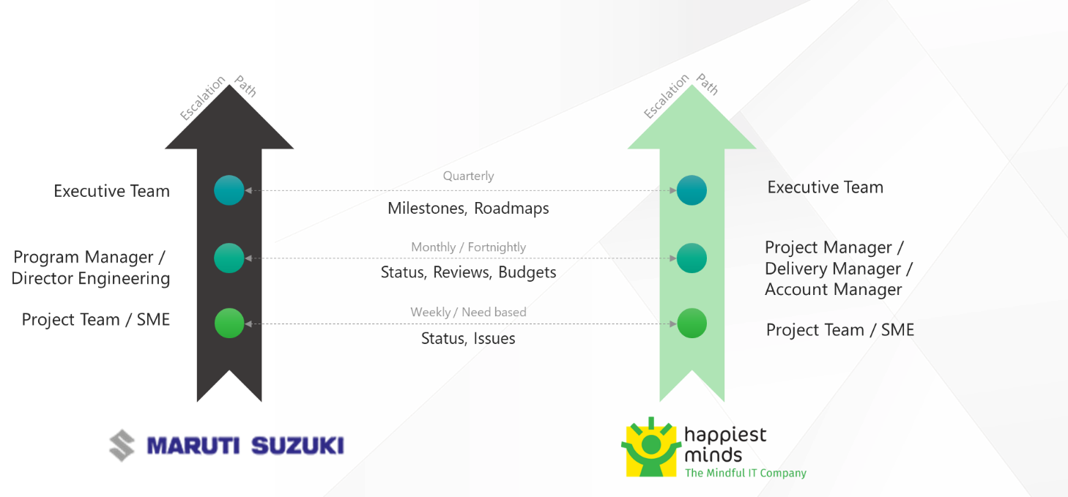
Governance and Communication Plan
Communication Area / Topic | Communication Activity Area(s) | Audience | Timeline/ Frequency | Owner
Daily Stand-up meeting | Discuss tasks completed, task planned and any outstanding blocking issues | Scrum Team | Daily | Scrum Master
Weekly Status meeting | Discuss weekly status report and next week’s plan, issues, risk | Program Manager, Project Manager, MSIL Project Sponsor | Weekly | Project Manager
Operations Review meeting | Discuss progress on the project, issues, and risk with resolution for project delivery and commercials | Program Manager, Project Manager, MSIL Project Sponsor | Monthly | Program Manager

Slide 19
Project Staffing
Happiest Minds
MSIL
# | Project Role
1 | Program Manager
3 | Platform Architect
4 | Backend Technical Lead
5 | Senior Backend developer
6 | UI Technical Lead
7 | Senior UI Developer
8 | DevOps Lead
11 | Performance Testing engineer*
12 | Test Lead
# | Project Role
1 | Product Owner
3 | Program Coordinator
The project will be executed in T&M engagement model.
The duration of engagement is expected to be between 12 to 15 months and can extend further based on the scope, dependency and activities planned for MVP1, 2 and 3
The team composition is indicative based on the requirement understanding and scope of work. Any change in scope would require additional effort and would be added after mutual discussion
*These roles will be onboarded based on the project schedule or as needed during the engagement

Slide 20
Our Expertise

Slide 21
Our Expertise
Predictive Asset Maintenance
Hybrid & Electric technology for class 8 trucks
Happiest minds built IoT platform that stores, monitors, and analyses critical real time data.
200 measurables parameters
50 different metrics
Implemented automation & integration into the data lake (truck telemetry data, Truck Master data, Finance report Automation)
Evaluate fitment into COTS Product
Provide Guidance on OOTB projects

Slide 22
Our Expertise
ERP transformation for a Leading EV company
Targeted advertising & stock out alerts at fuel stations
Implemented end to end capabilities such as
Order to cash
Procure to Pay
Helped provide greater control on
Sales process
Billing and tracking transparency
Enable customer engagement at gas stations/EV charging stations
Supported product stock out identification & notification
Provided a mechanism to display targeted ads on dispenser/Kiosk
Provided better inventory management

Slide 23
Amit Kumar
Client Partner – Siemens
amit.kumar7@happiestminds.com
+1-4085719302

